Slide 1

Microsoft Fabric Bootcamp- English/Hindi

Slide 2





Amit Chandak
Learn Power BI
YouTuber
BIWorld.in
CAO- Kanerika
https://www.linkedin.com/in/amitchandak78/
Join For Live class update
YouTube
LinkedIn

Slide 3

Power BI Course with Certificate

Slide 4
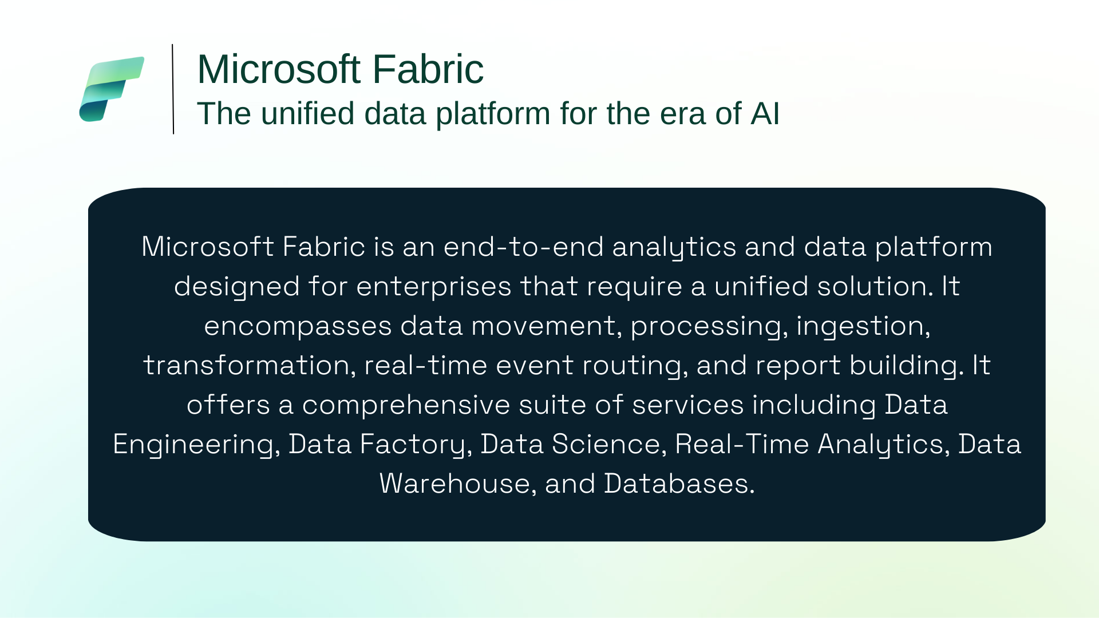

Slide 5


Slide 6

Why should I learn Microsoft Fabric?

Slide 7
Why should I learn Microsoft Fabric?
Comprehensive Platform: Microsoft Fabric brings together data integration, engineering, warehousing, analytics, and visualization in a single, unified platform.
Natural Upgrade for Power BI Users: If you already use Power BI, Fabric is the next step to advance your analytics skills and leverage the latest innovations.
Rapid Market Adoption: Microsoft Fabric is gaining traction quickly, with more organizations adopting it for their data and analytics needs.
Cost-Effective Solution: Many customers are finding that Fabric helps reduce costs by consolidating multiple data and analytics tools into one solution.
New Technology, New Opportunities: As a recent launch, there are many growth and career opportunities for professionals who learn Fabric early.

Slide 8
Do we need a new system for data analytics?

Slide 9
Data Analytics
Business intelligence is related to decision making
olap.com “The term Business Intelligence (BI) refers to technologies, applications and practices for the collection, integration, analysis, and presentation of business information. The purpose of Business Intelligence is to support better business decision making.”

Slide 10
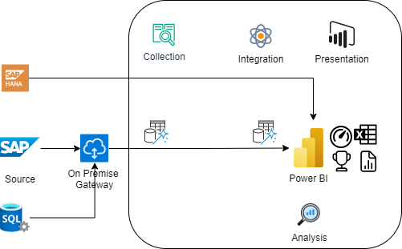
Power BI

Slide 11
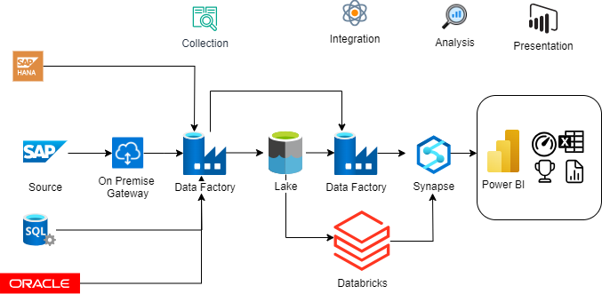
Azure

Slide 12
Today’s data and analytics challenges
Data and analytics challenges
Growing BI adoption to drive a data-driven organization across LOBs and teams
Scaling data and analytics across the organization while reducing costs and optimizing existing data and management
Making data more accessible to technical and non-technical users in a governed and secure way
Breaking down data siloes and eliminating unnecessary data sprawl
Notes:
We’ve talked to a wide range of customers who have led their organizations in data-first modernization. And we understand that businesses today face a variety of data and analytics challenges that can be difficult to navigate.
To put this into perspective, research shows “the amount of data created over the next three years will be more than the data created over the past 30 years.” Accessing and managing real-time data on the cloud is a top priority for long-term success. Investing in a comprehensive data & analytics platform can address the hurdles encountered in your current data ecosystem.
Source: IDC Global DataSphere Forecast, 2020

Slide 13

What is current Ecosystem?

Slide 14
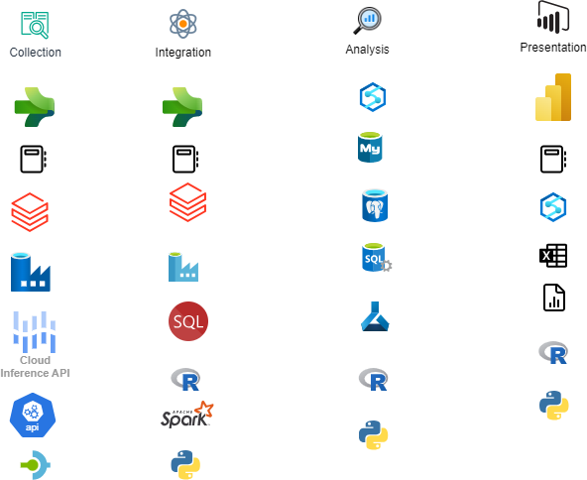
Choices – Chief Integration Office?

Slide 15
Data and analytics challenges
Many Products
Different Experiences
Different License
Different Configurations
Proprietary and Open
Dedicated and Serverless
PaaS and SaaS
Different Business Models
Steep Learning Curves
Deep Expertise Needed
High Integration Effort
Multiple copies of Truth
Long Development Cycles
Cost – Too Many factor to Manage
Notes:
We’ve talked to a wide range of customers who have led their organizations in data-first modernization. And we understand that businesses today face a variety of data and analytics challenges that can be difficult to navigate.
To put this into perspective, research shows “the amount of data created over the next three years will be more than the data created over the past 30 years.” Accessing and managing real-time data on the cloud is a top priority for long-term success. Investing in a comprehensive data & analytics platform can address the hurdles encountered in your current data ecosystem.
Source: IDC Global DataSphere Forecast, 2020

Slide 16
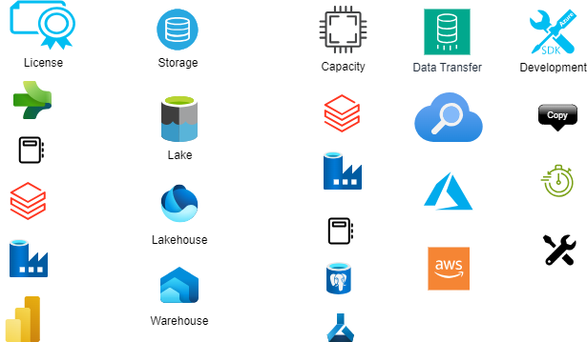
Cost

Slide 17
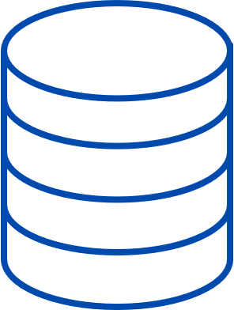


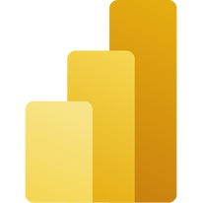


Current Ecosystem
Copy to Lake House
Copy to Warehouse
Copy Data to BI Tool
Challenges in Data Analytics Cycle - Multiple Sources
Copy
Copy
Copy
Another Copy for Data Science

Slide 18
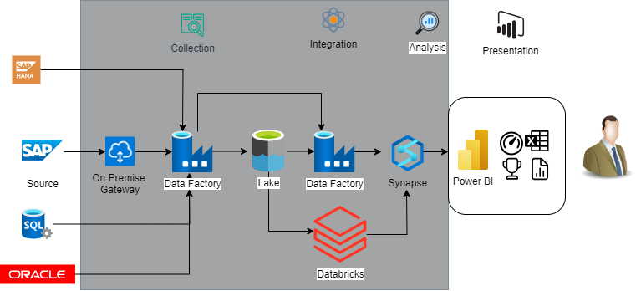
The Black Box

Slide 19
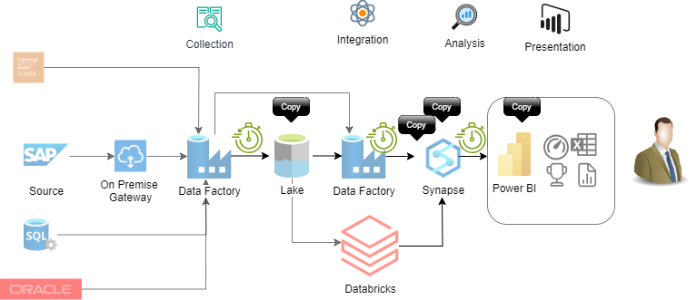
Longer Development Cycle

Slide 20

The One
Microsoft Fabric

Slide 21
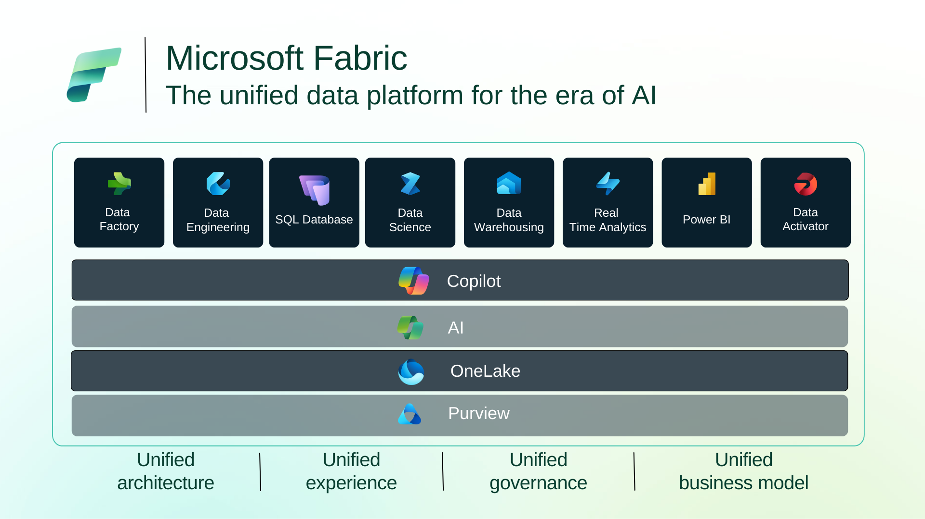











Microsoft Fabric
The unified data platform for the era of AI
Data
Factory
Synapse Data
Engineering
Synapse Data
Science
Synapse Data Warehousing
Synapse Real Time Analytics
Power BI
Data Activator
AI
OneLake
Purview
Unified
architecture
Unified experience
Unified governance
Unified business model

Slide 22
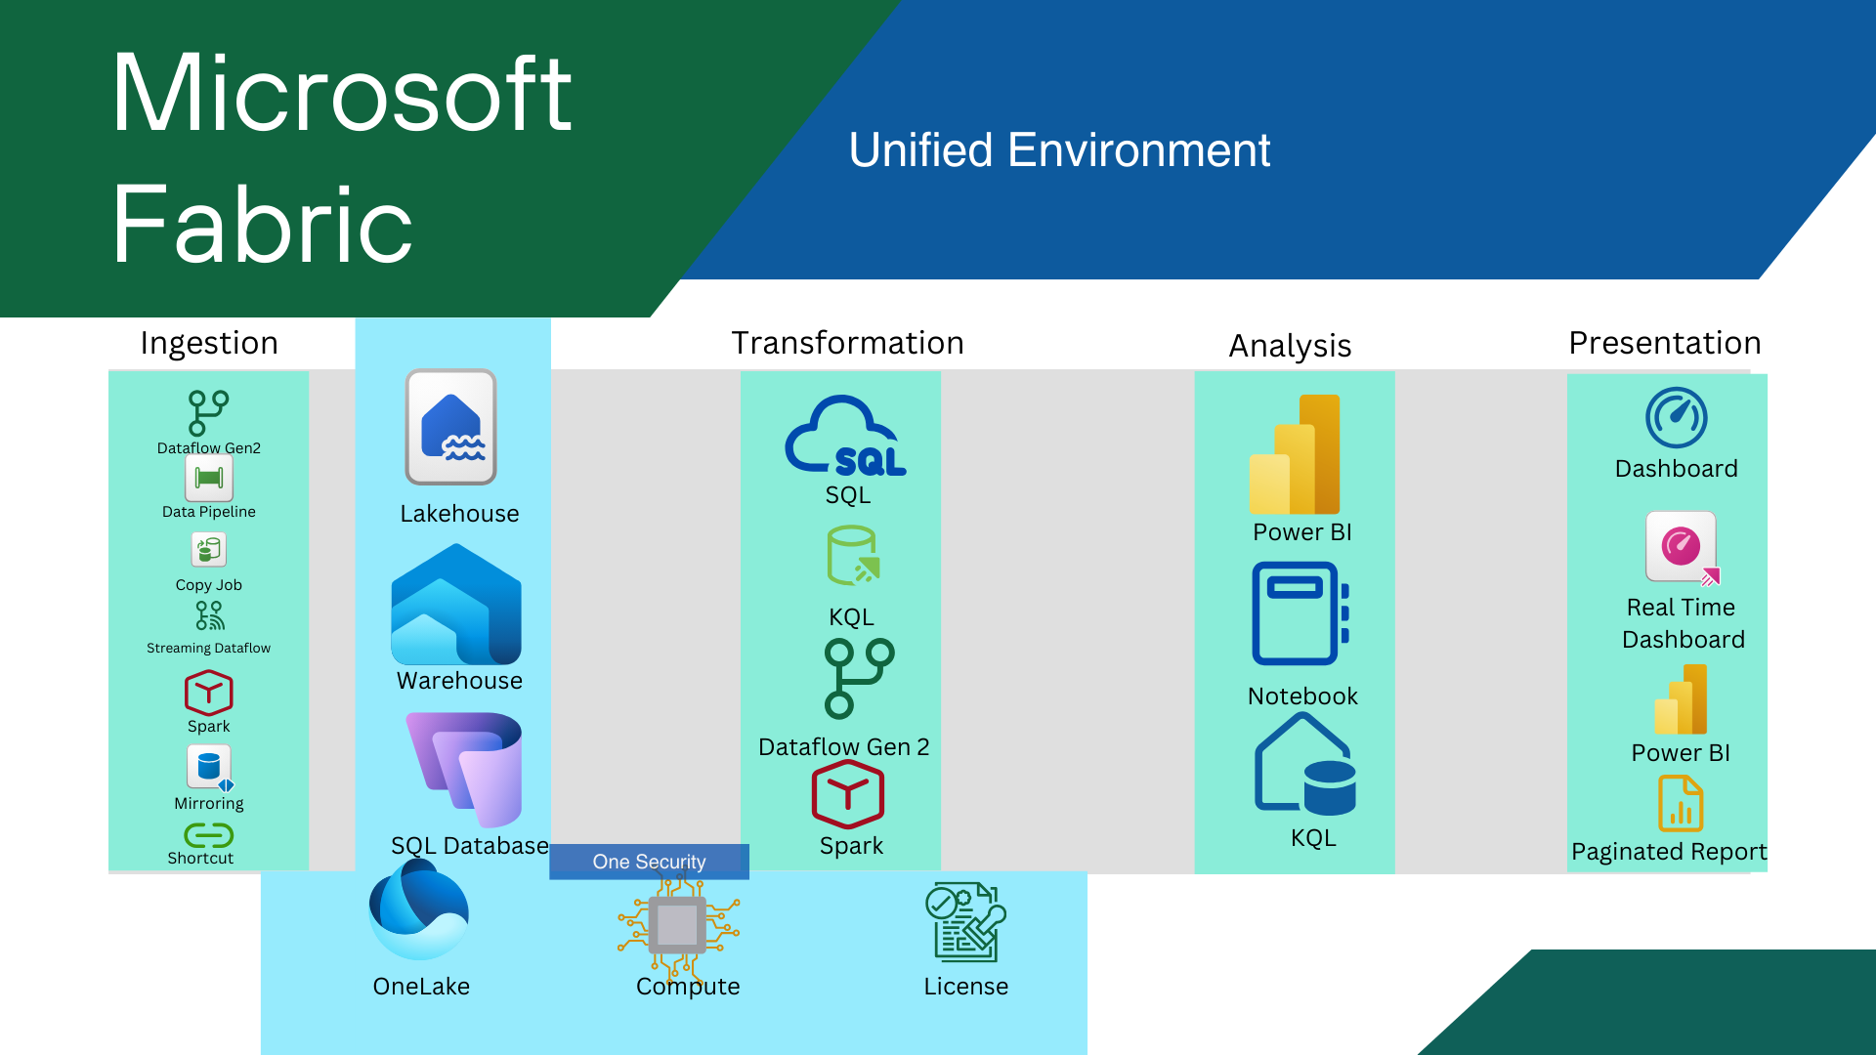

Slide 23

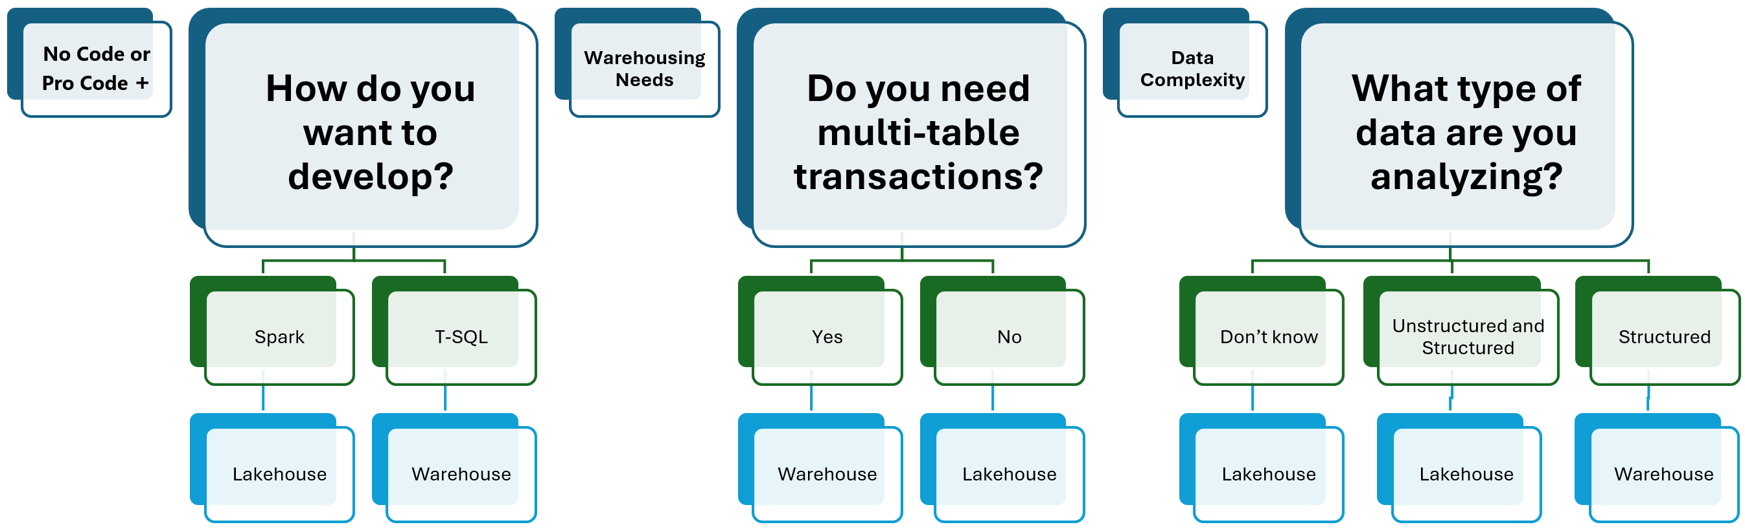

Slide 24
Microsoft Fabric
How to Choose
Structured/Any
OLTP/OLAP
SQL DB
Warehouse
Any
Lakehouse
T-SQL/Spark
OLTP/OLAP
SQL DB
Warehouse
OLAP
Lakehouse

Slide 25
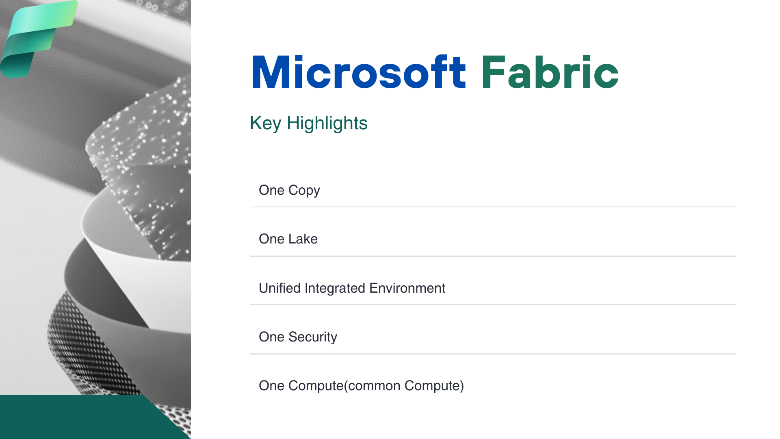
Microsoft Fabric

Slide 26
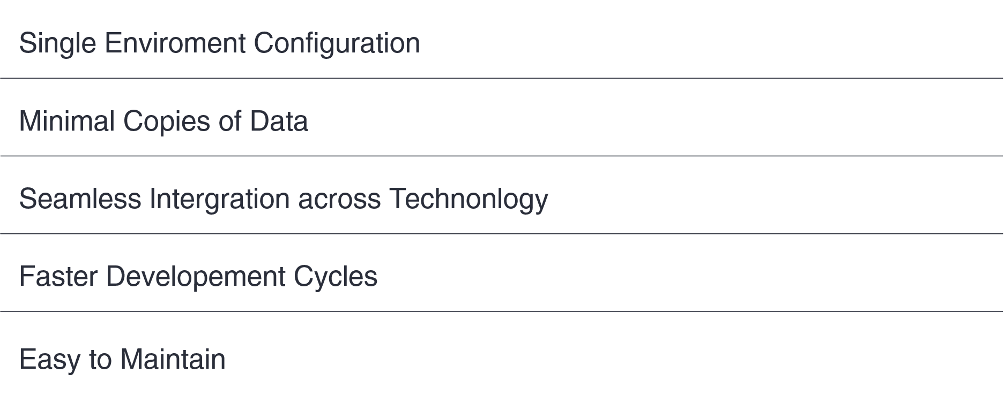
Benefits
Microsoft Fabric
Microsoft Fabric Vs Others

Slide 27
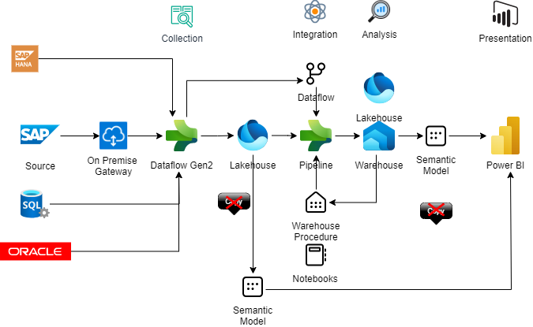
One Copy
Microsoft Fabric

Slide 28
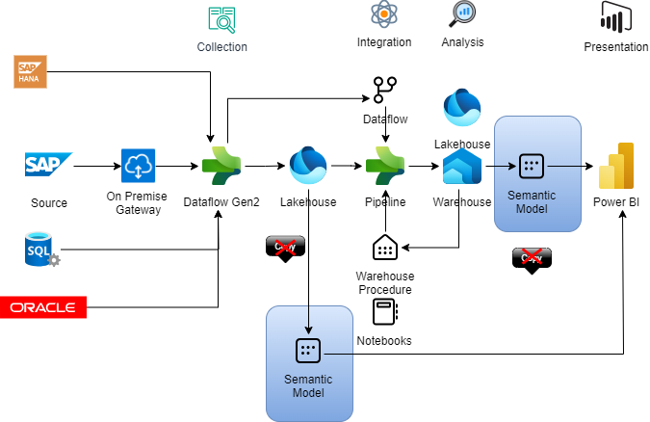
No Black Box
Microsoft Fabric

Slide 29
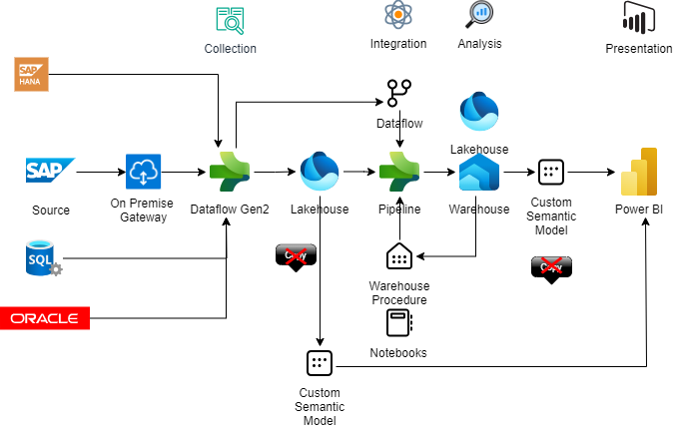
Optimized Development Cycle
Microsoft Fabric

Slide 30
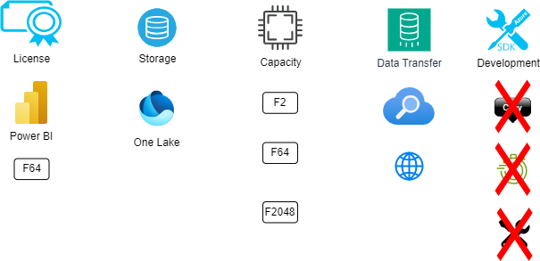
Cost
Microsoft Fabric

Slide 31
Fabric Pricing pay as you go
Microsoft Fabric
SKU | Capacity unit (CU) | Pay-as-you-go | Reservation
F 2 | 2 | $262.80/month | N/A
F 4 | 4 | $525.60/month | N/A
F 8 | 8 | $1,051.20/month | N/A
F 16 | 16 | $2,102.40/month | N/A
F 32 | 32 | $4,204.80/month | N/A
F 64 | 64 | $8,409.60/month | N/A
F 128 | 128 | $16,819.20/month | N/A
F 256 | 256 | $33,638.40/month | N/A
F 512 | 512 | $67,276.80/month | N/A
F 1024 | 1024 | $134,553.60/month | N/A
F 2048 | 2048 | $269,107.20/month | N/A

Slide 32
Fabric Pricing pay as you go
Microsoft Fabric
Storage | Price
OneLake storage/month** | $0.023 per GB
OneLake BCDR storage/month | $0.0414 per GB
OneLake cache/month* | $0.246 per GB
OneLake cache is billed for KQL cache storage and Data Activator data retained.
When a workspace associated with Fabric capacities is deleted, customers will be charged for OneLake storage of the deleted workspace during its retention period. The retention period for all collaborative workspaces, including those associated with Fabric capacities, will be configurable from 7 to 90 days.
Power BI native storage (separate from OneLake storage) continues to be free up to the maximum storage correlated with your Power BI plan and data stored in OneLake for Power BI import semantic models is included in the price of your Power BI licensing.
Power BI native storage is separate from OneLake storage and continues to be free up to the maximum storage correlated with your Power BI plan—10 GB per user for Power BI Pro plans and 100 TB for Power BI Premium per user. Data stored in OneLake for Power BI import semantic models is included in the price of your Power BI licensing.

Slide 33
Free Mirroring Storage
Microsoft Fabric
Capacity SKU | Free Mirroring storage for replicas (up to X TB)
F 2 | 2
F 4 | 4
F 8 | 8
F 16 | 16
F 32 | 32
F 64 / P1 | 64
F 128 / P2 | 128
F 256 / P3 | 256
F 512 / P4 | 512
F 1024 / P5 | 1024
F 2048 | 2048

Slide 34
Who will go for Fabric
Power BI Premium capacity Customer
Power BI customer looking for upgrade
Tableau customer looking for migration
Customer having DW on AWS on MS technology
Azure Synapse, Databrick, Data Factory
SSIS, SSAS, AAS
BI tools reaching EOL

Slide 36
Microsoft Fabric
Microsoft Fabric
The data platform for the era of AI
Complete Analytics Platform
Lake centric and open
Empower Every Business User
AI Powered
Everything, unified
OneLake
Familiar and intuitive
Copilot accelerated
SaaS-ified
One Copy
Built into Microsoft 365
ChatGPT on your data
Secured and governed
Open at every tier
Insight to action
AI driven insights

Slide 37
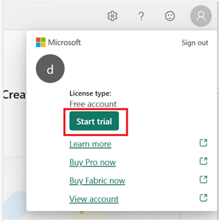
Microsoft Fabric
Microsoft Fabric
Start Trial

Slide 38

One Lake
Microsoft Fabric
delta parquet format
delta parquet format
Microsoft Fabric’s foundation lies in the data lake, which is also known as OneLake. OneLake is an integral part of the Fabric service, providing a centralized location to store all organizational data, ensuring seamless operation across various experiences.
OneLake, similar to OneDrive, is automatically included with every Microsoft Fabric tenant. It serves as the single repository for all analytics data, catering to the entire organization. This logical data lake, OneLake, is built on top of Azure Data Lake Storage (ADLS) Gen2, offering a unified Software-as-a-Service (SaaS) experience for both professional and citizen developers

Slide 39
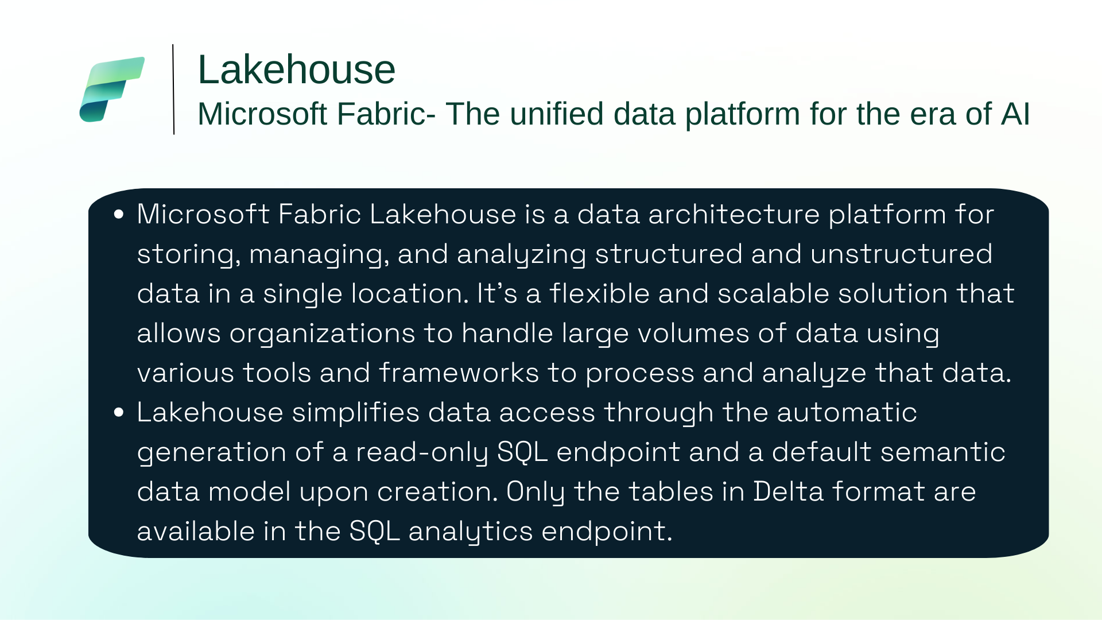

Slide 40
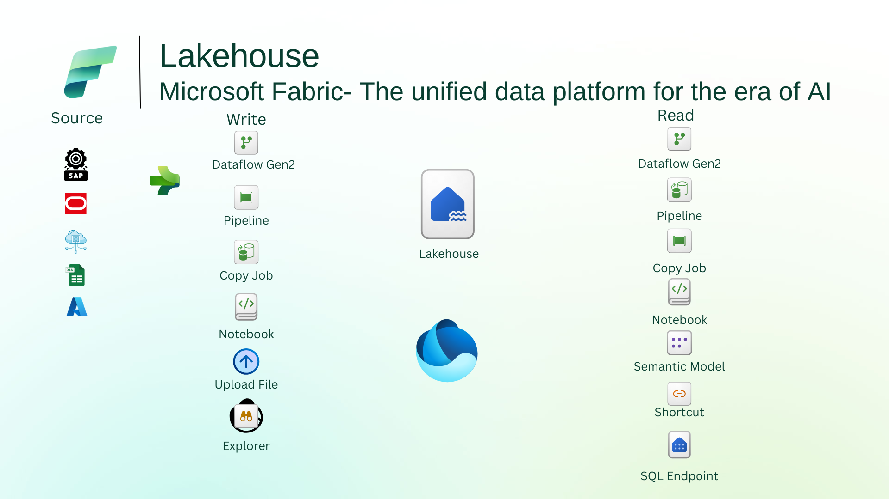

Slide 41
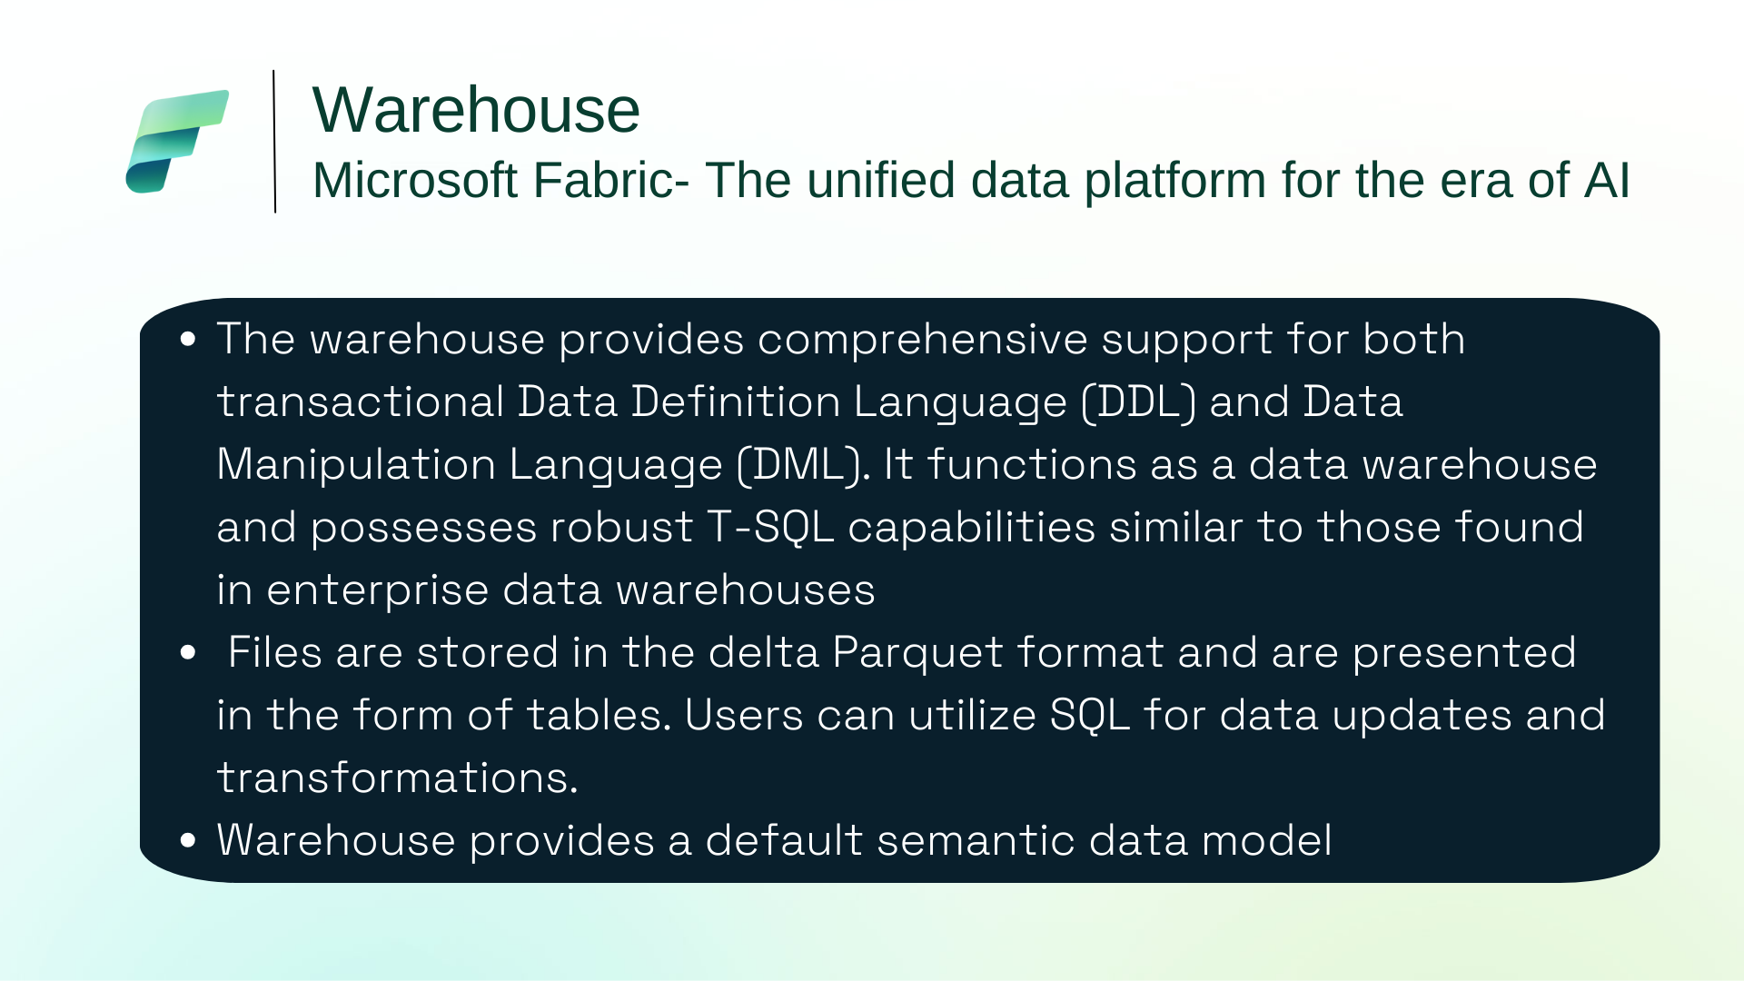

Slide 42
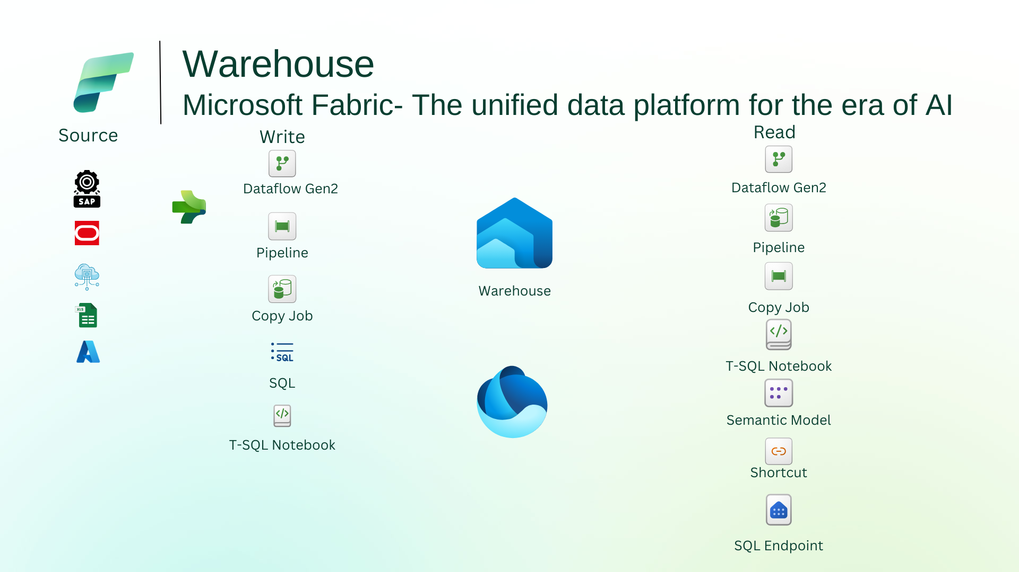

Slide 43
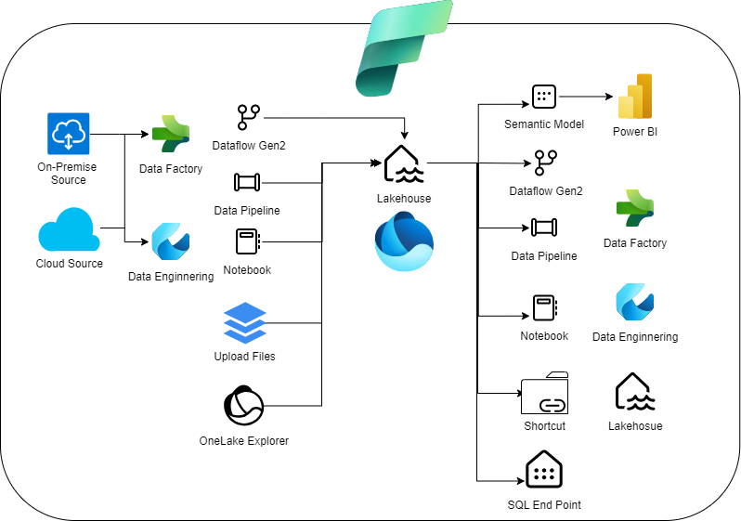

Slide 44

LakeHouse
Microsoft Fabric
Key Highlights
Microsoft Fabric Lakehouse is a cutting-edge data architecture platform designed to efficiently store, manage, and analyze both structured and unstructured data within a unified storage system
By seamlessly integrating structured and unstructured data, the Lakehouse enables organizations to derive valuable insights from their data assets in a single, consolidated location
Lakehouse simplifies data access through the automatic generation of a read-only SQL endpoint and a default dataset upon creation
This SQL endpoint provides users with convenient access to the data for analysis and querying purposes

Slide 45

WareHouse
Microsoft Fabric
Key Highlights
The warehouse provides comprehensive support for both transactional Data Definition Language (DDL) and Data Manipulation Language (DML). It functions as a data warehouse and possesses robust T-SQL capabilities similar to those found in enterprise data warehouses
Managed by a SQL engine, the Warehouse facilitates data updates through pipelines, SQL, Spark, and shortcuts. Files are stored in the delta Parquet format and are presented in the form of tables. Users can utilize SQL for data updates and transformations.
Unlike the SQL Endpoint, which automatically generates tables and data, you have complete control over creating tables, loading data, performing transformations, and executing queries within the data warehouse. This can be achieved through either the Microsoft Fabric portal or T-SQL commands.
Warehouse provides a default dataset for your convenience

Slide 46
